Slide 1

Debug React Native Apps
Because There Will Be Errors
Jack
2022.1.6

Slide 2
Table of Contents
Introduction
What to Debug & How to Debug?
Running the App on a Real Device & Debugging
Handling Error Messages
Understanding Code Flow with console.log()
Using the Remote Debugger & Breakpoints
Working with the Device DevTools Overlay
Debugging the UI & Using React Native Debugger
Debugging React Native in VS Code
Wrap Up
Useful Resources & Links

Slide 3
Requirements
A little React knowledge
A little JavaScript knowledge

Slide 4

Introduction
We will have a look at what we can do when things go wrong, namely at debugging React Native apps because there always will be some errors and there are different tools you can use to track down your errors, to fix them or to avoid them at runtime

Slide 5
What to Debug?
Error Messages / App Crashes
Logic Errors
Styling. Layout & UX
Syntax errors
Undesired or unexpected app behavior
Unexpected / “wrong” styling or layout
Bugs in your codes. (e.g. using undefined value, wrong types…)
Unexpected / Unhandled user behavior
Inconsistent result on different devices
“Unavoidable errors” (e.g. failing network requests)
Sequence of steps lead to errors
Layout doesn’t “work” on certain devices or orientations

Slide 6
How to Debug?
Read the error messages (seriously)!
Often, you the error messages contains the solution or a (pretty) exact pointer at the problematic code line.
console.log()
Get a feeling for the “flow” of your code(What happens when? Which value is used where?)
Other debuggers(e.g. Chrome)
Dive into the code in great detail and step by step.

Slide 7
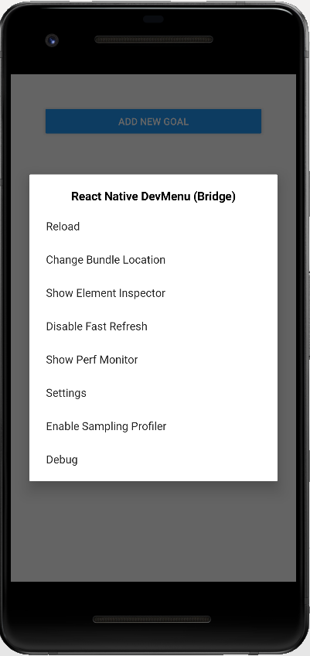
Running the App on a Real Device & Debugging
With the app running on a real device, you can debug it from there, too. Shake the device a little to bring up the developer menu.
There, you can enable the debugger and the other features covered on this slide.

Slide 8
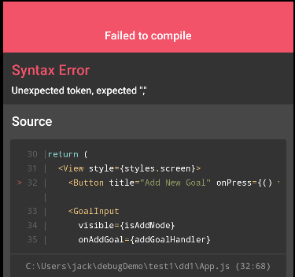
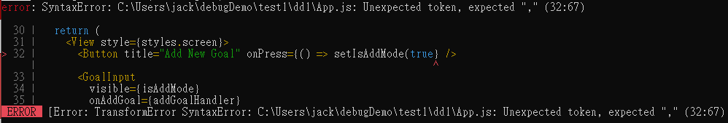
Handling Error Messages: Syntax Error
Missing bracket
App.js
Metro log
It's still pointing us at the wrong solution, expecting a comma but it does point us at the right code
Device log
Notes:
Chrome DevTools
https://developer.chrome.com/docs/devtools/

Slide 9
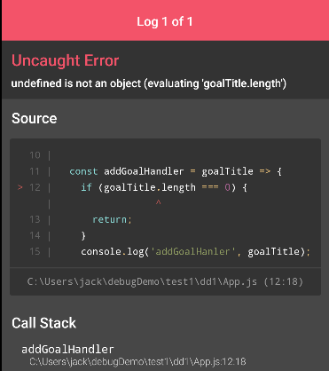
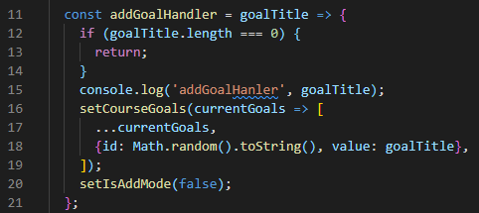
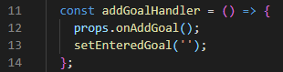
Handling Error Messages: Bugs in Your Codes
Undefined value
App.js
Do length check
GoalInput.js
Forgot to return value
Device log
It informs us that the problem has something to do with something being undefined and that it is related to this goal title length check.
Notes:
Chrome DevTools
https://developer.chrome.com/docs/devtools/

Slide 10
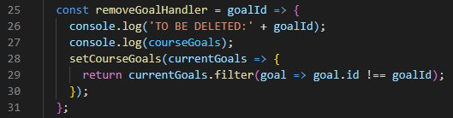
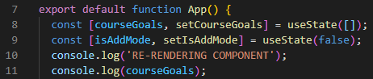
Understanding Code Flow with console.log()
Add some info text like to be deleted in front of this
App.js
The entire component will be re-rendered when we update our course goals with this line
So we can maybe just also add a little console log, re-rendering component, so that we know that the course goal list we're printing after this one is the list after every re-render cycle
We of course see that that‘s behaving correctly here but simply imagine you have a more complex flow in your code you want to debug, then such console log statements can really help you understand how your code is running, how often it's running and if the correct values are getting used.

Slide 11
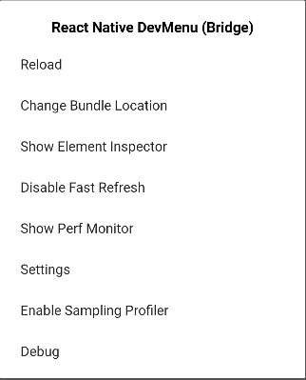
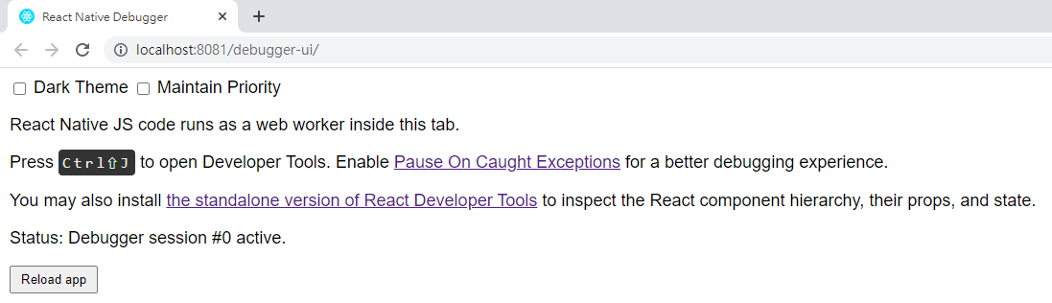
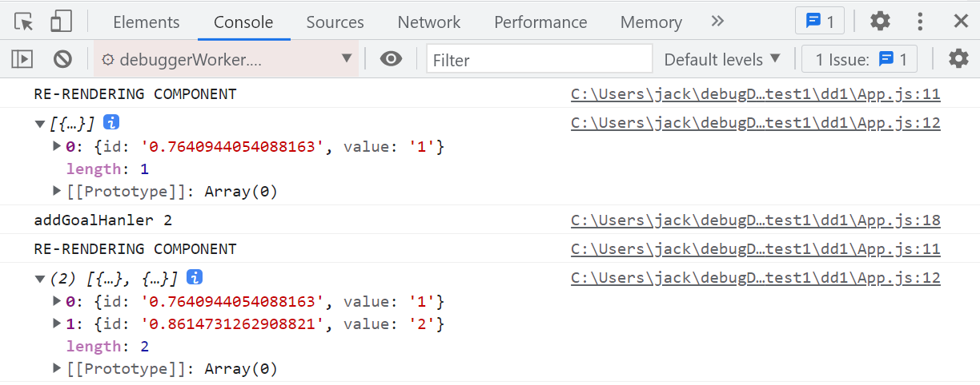
Using the Remote Debugger & Breakpoints: Launch
Now sometimes, console log alone doesn't get you that far, you need more help and in such cases, you can debug your code remotely.
On Android simulator, you press control m and it will open debug menu
If you press Debug, a new tab should open up in the browser which automatically navigated to localhost http://localhost:8081/debugger-ui/
You can open the Chrome developer tools now with the shortcut you should be seeing here

Slide 12
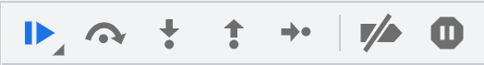
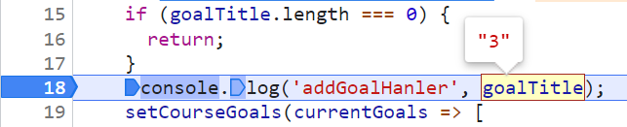
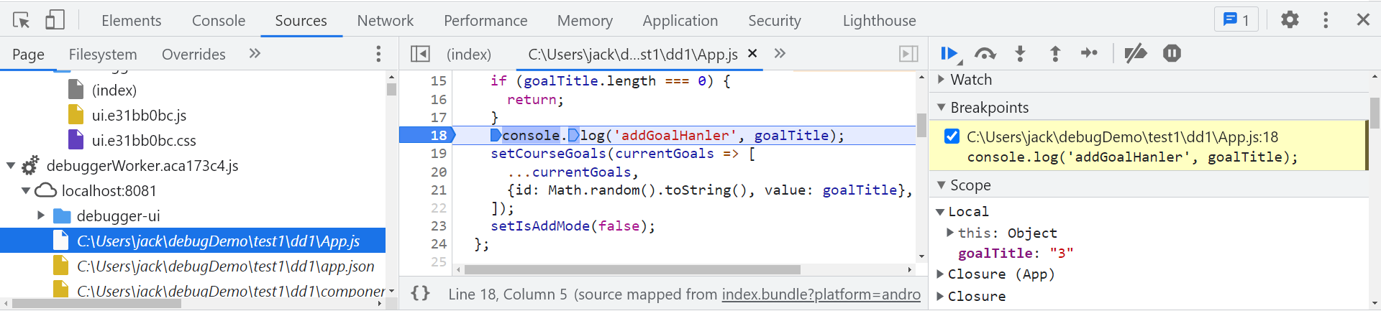
Using the Remote Debugger & Breakpoints: Set Breakpoints
You can dive into sources for example to dive into your source code and set breakpoints.
Now the cool thing is you can walk through your code step-by-step with these controls and you can also hover over things to look into your code, for example to see the current value in goal title.

Slide 13
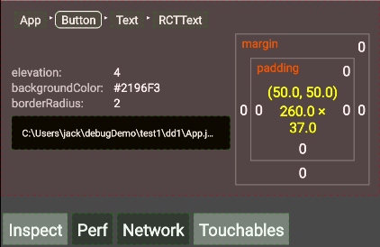
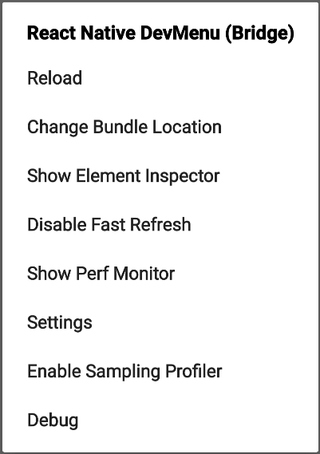
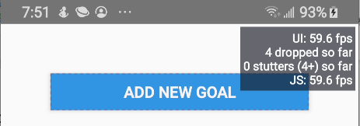
Working with the Device DevTools Overlay
If you enable Perf Monitor, you get this overlay which basically informs you about the performance you are having and there you can see at how many frames your app is running, how many frames were dropped and so on.
If you enable Element Inspector, you can click onto items in your user interface to get information about them.
Notes:
https://reactnative.dev/docs/performance

Slide 14
Debugging the UI & Using React Native Debugger
There are several even better tools for inspecting the user interface, like React Native Debugger
For this to work, enable remote JavaScript debugging on the devices, just what we did before to debug this in Chrome.
Now with this opened up, press command t on Mac or control t on Windows or Linux in here to open a new tab and open and confirm that React Native debugger port which the Chrome tab also used before and confirm this and now it's trying to connect there and to make this succeed, and you'll see your console output here now in the debugger tools.
Notes:
Ctrl +Ｔ

Slide 15
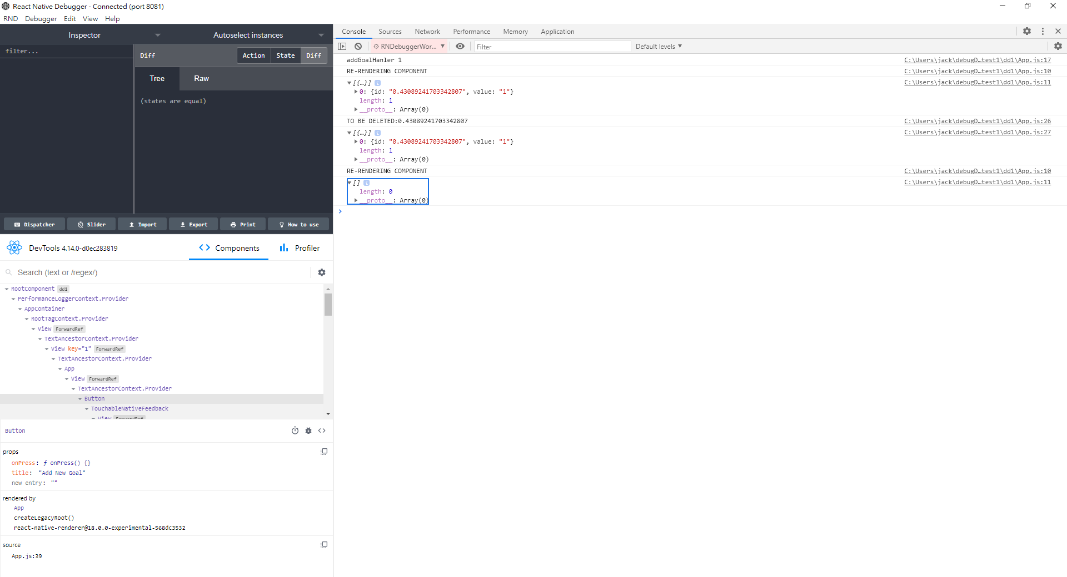
React Native Debugger: Console Output
Console output here now in the debugger tools

Slide 16
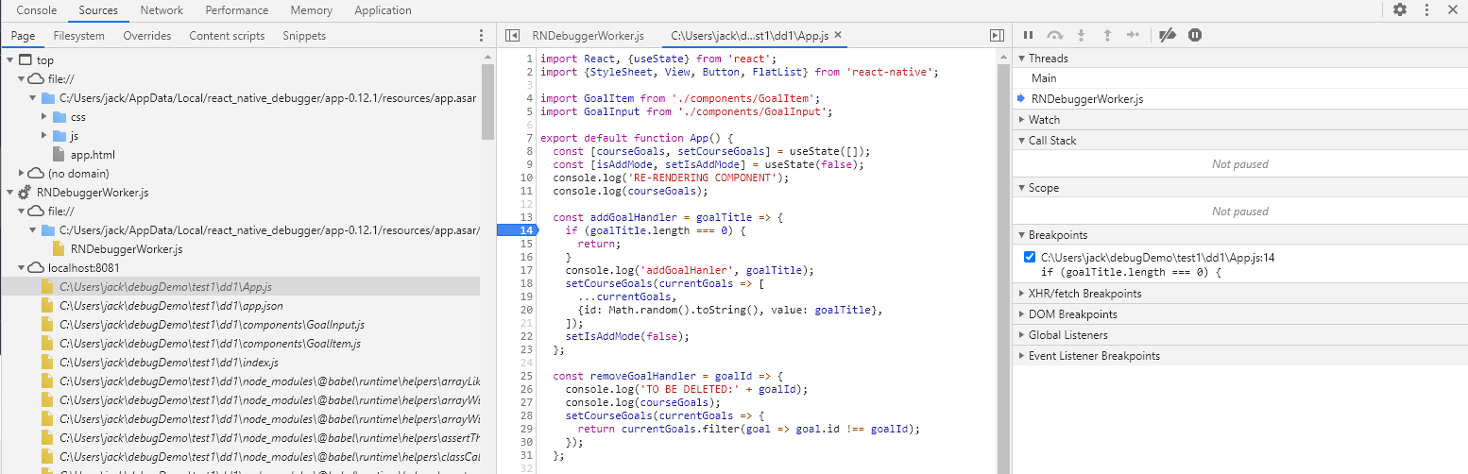
React Native Debugger: Sources
You'll also see, if I expand this, that in sources, you can again dive into your code here if you want to.

Slide 17
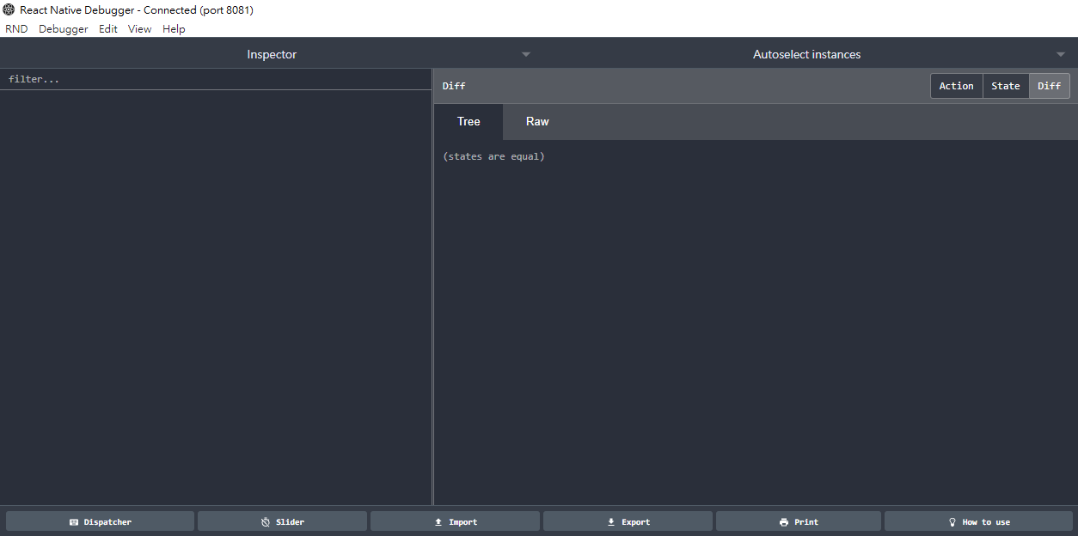
React Native Debugger: Redux
We‘re not using Redux here, so they’re pretty nothing going on here
Redux debugging tools

Slide 18
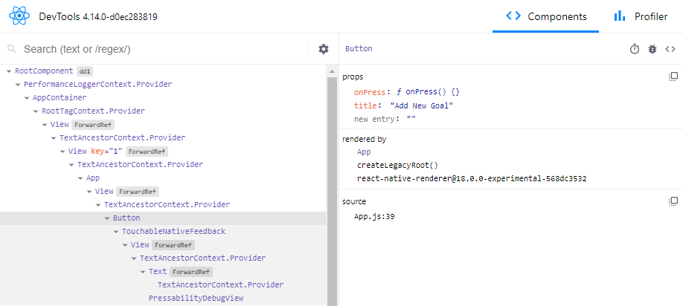
React Native Debugger: Elements
This allows you to explore your React Native jsx code so to say, so your element, your component tree
You can dive into the root component to then find our app component down there and in there, we find our view with that button, we can click on the button and we see the props that we're using on the button, like onPress
Elements debugging tool

Slide 19
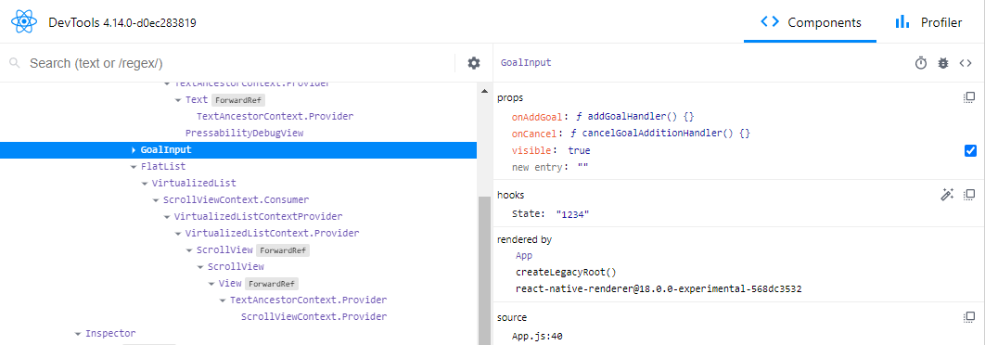
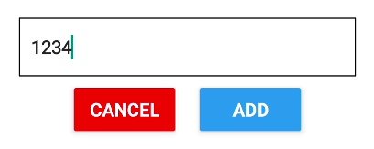
React Native Debugger: Props and States of Elements
We can even change the visible prop to toggle this modal like this if we want to
if I start typing here, like 1234, you'll see that this also updates here

Slide 20
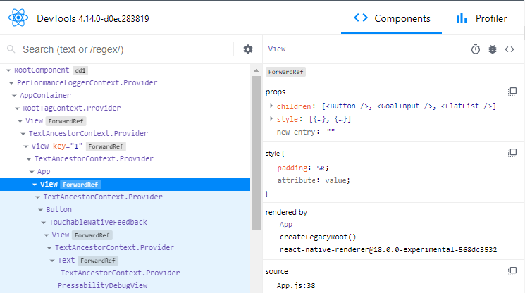
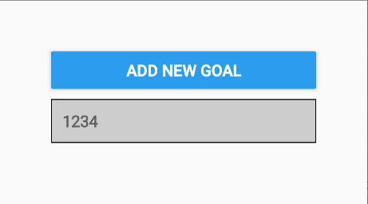
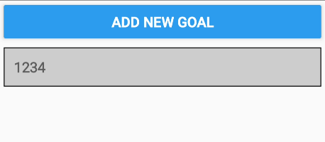
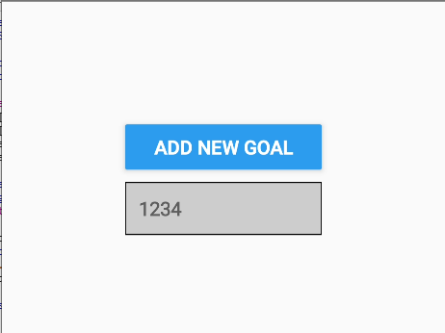
React Native Debugger: Styles
You can even inspect the style and not just see the style but also change it, for example to increase the padding or reduce it and this gives you an easy way of testing different looks and layouts on the screen to find out what’s looking good for you and what you want to change.

Slide 21
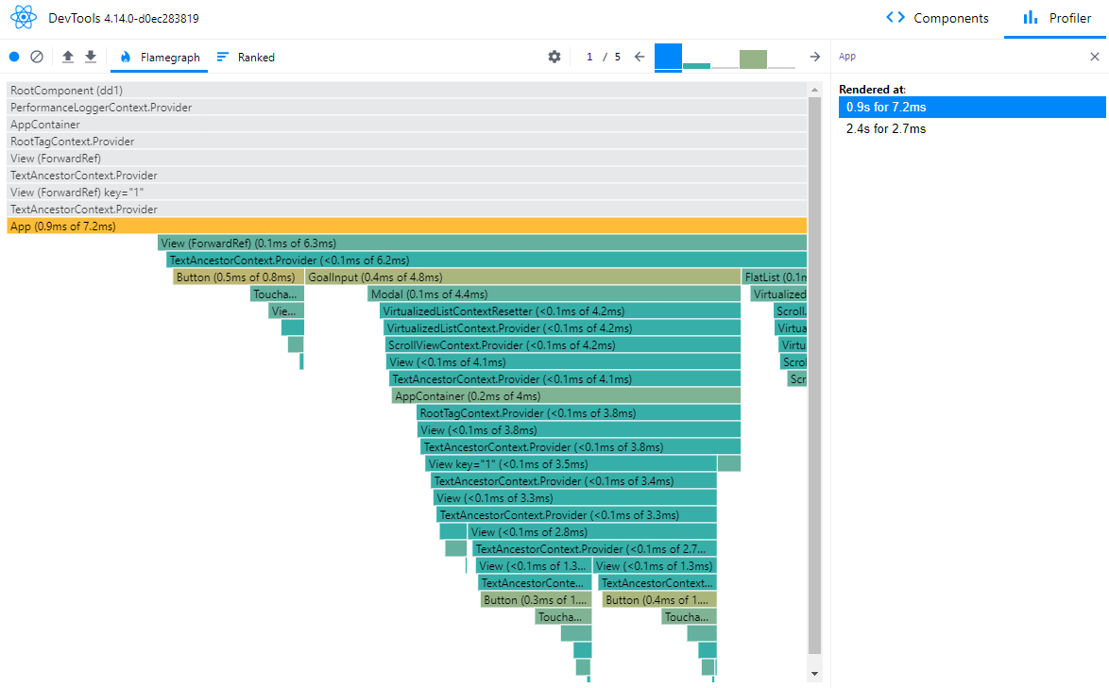
React Native Debugger: Profiler
You can also go to the profiler tab here and start a profiling session, then do something on the screen like open and close the modal and stop this and you'll get the default React dev tools experience here where you see which of your components were repainted and you can dive into that to get an idea for what was repainted, which props it had at the time and how many re-render cycles you had to
Notes:
https://blog.logrocket.com/debugging-react-applications-with-the-react-profiler-api-and-the-profiler-devtool/

Slide 22
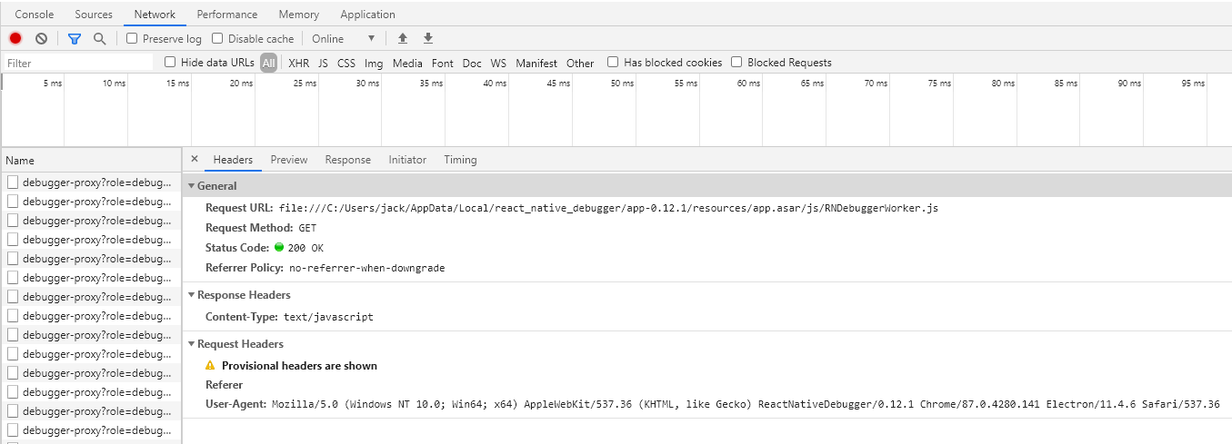
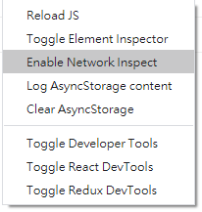
React Native Debugger: Network
You can right click anywhere here, , then you can go to the network tab and you'll see outgoing network requests.
Now these are all just debugging related requests but later in the course when we'll add our own network requests, where we send requests to our own web server, we can even inspect those here and look into them and see if we're sending and receiving the right data, something which is otherwise pretty hard to do with.

Slide 23
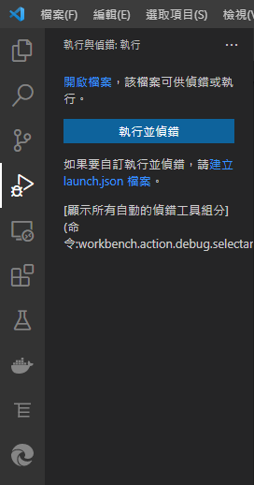
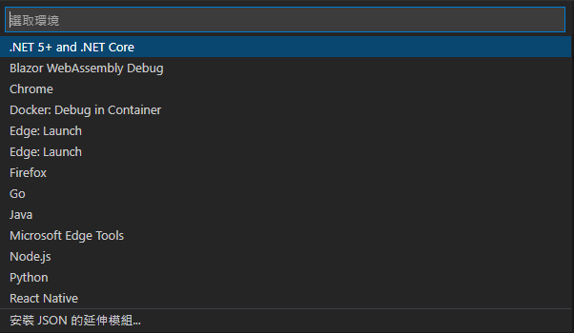
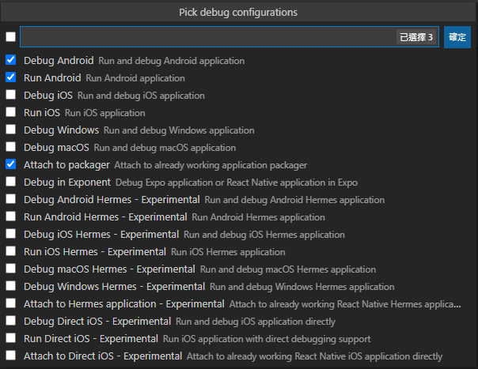
Debugging React Native in VS Code: Prerequisites
VS Code installed
React Native environment set up: https://reactnative.dev/docs/environment-setup
Install Microsoft’s React Native Tools extension for VS Code
Open launch.json from the .vscode directory and add debug configurations
Notes:
https://code.visualstudio.com/docs/nodejs/nodejs-debugging

Slide 24
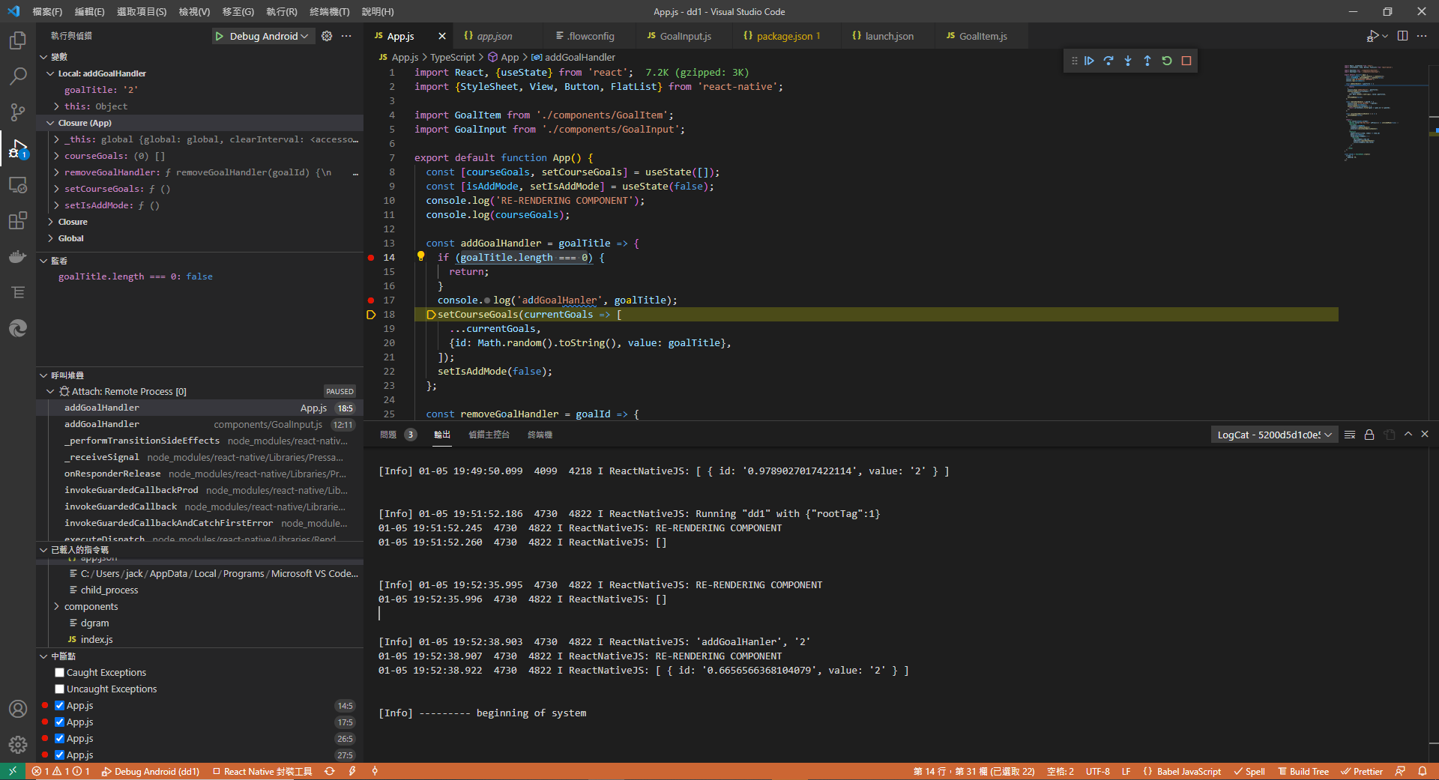
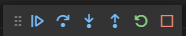
Debugging React Native in VS Code: Enjoy Debugging!
Toolbar
Side panel

Slide 25
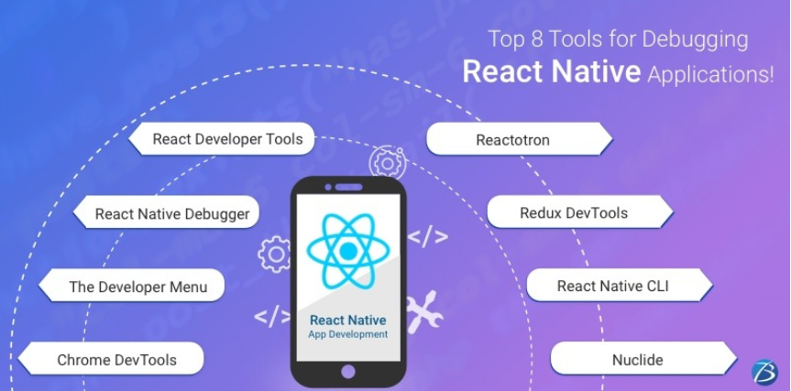
Top 8 Tools for Debugging React Native Applications
Notes:
https://telegra.ph/Top-8-Tools-for-Debugging-React-Native-Applications-12-17

Slide 26
Wrap Up
So now we had a detailed look at the React Native debugging experience, at the React Native debugger and the different tools you have for finding and fixing errors, for analyzing your user interface, your component tree
React Native debugger really is a cool tool for looking into your app, for setting breakpoints, viewing the console, viewing your component tree, viewing the styles you‘re using there and so much more. It really allows you to dive deeply into your application code, into your UI, into your logic and find out if everything is working the way it should work and you can even go in here and change certain things like the styling as you saw, to experiment with different settings and find out where you need to tweak your app for it to work correctly.
Just simply debugging React Native in VS Code
Notes:
TODO: add chart mind chart
Unavoidable error to be continued

Slide 27
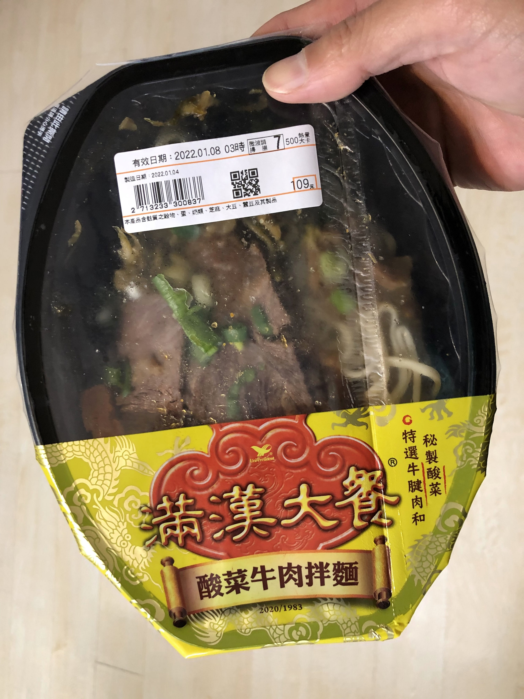
Maybe the Best Debugging Tool For You Is Yet to Come

Slide 28
Useful Resources & Links
Debugging https://reactnative.dev/docs/debugging
Chrome Dev Tools https://developers.google.com/web/tools/chrome-devtools/
React Native Debugger https://github.com/jhen0409/react-native-debugger

